Slide 1


Electviz: Election Data Visualization for Media
Github:https://github.com/Payal1726/Infosys_ElectViz-Election-Data-Visualization-for-Media-Team-A-
PRESENTED BY TEAM A
Payal Shinde Mohammad Saad
Jyothi Reddy
Gowtham Mani
Kumari Divya Sree

Slide 2
Problem Statement
During elections, media organizations operate in a fast-paced and high-pressure environment where timely and accurate information is critical. Election data is vast, complex, and collected from multiple sources, making it challenging to organize, analyze, and present in a meaningful way. Without a structured and interactive system, understanding trends such as vote share, turnout patterns, party performance, and constituency-level results becomes difficult. Therefore, there is a need for a centralized and dynamic dashboard solution that transforms raw election data into clear, insightful visual reports, enabling journalists and editorial teams to deliver precise, data-driven coverage to the public.

Slide 3
Project Objectives
Integrate public election datasets​.
Enable real-time result tracking.​
Provide vote share and turnout analysis.​
Support party and candidate performance evaluation​.
Deliver broadcast-ready visual dashboards​.

Slide 4
Key Outcomes
Unified election data (state & national levels)​.
Real-time election result tracking​.
Party-wise & candidate-wise dashboards​.
Geographic mapping of results​.
Scalable model for future election.

Slide 5
Module 1 – Data Integration & Modeling
Imported data from CSV, Excel.
Cleaned & normalized constituency and candidate data​.
Created Star Schema model​.
Fact_ElectionResults & Dimension tables​.
Established relationships for accurate reporting​.

Slide 6
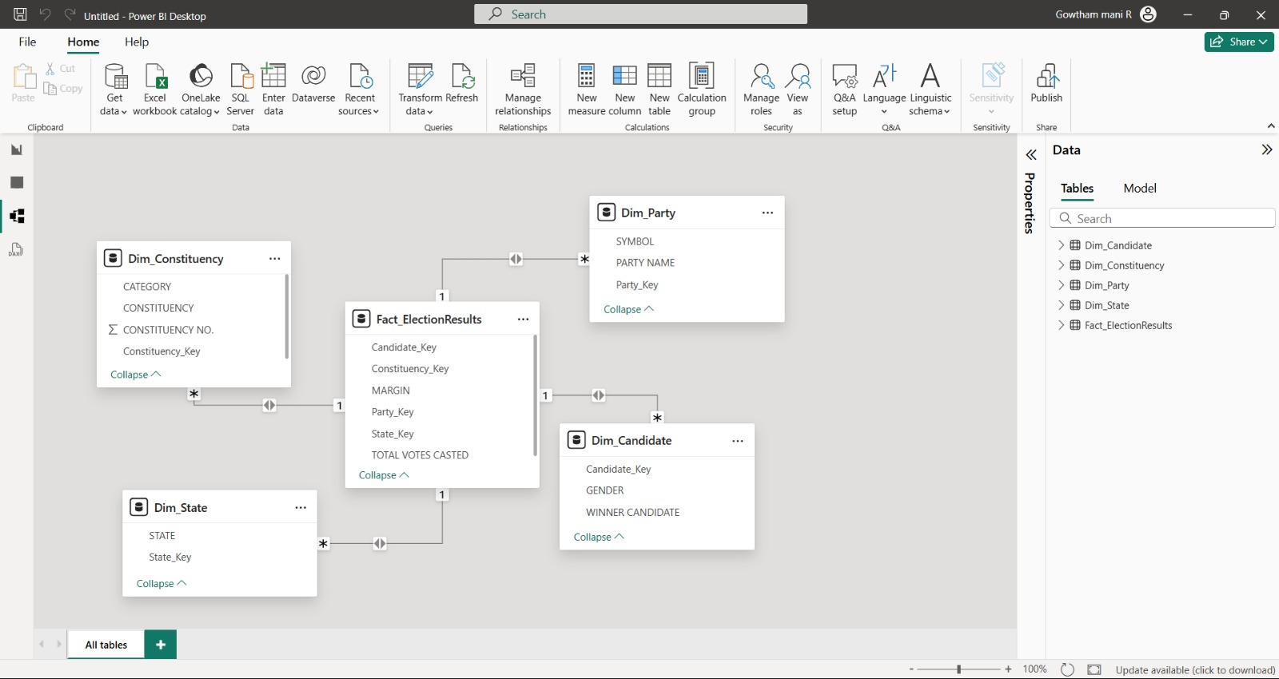
Data Integration &Modeling

Slide 7
Module 2 – Historical Trends Dashboard
Visualized vote share & turnout across years.
Line charts & area charts for party trend analysis.
Identified swing constituencies.
Enabled filters (year, region, party).

Slide 8
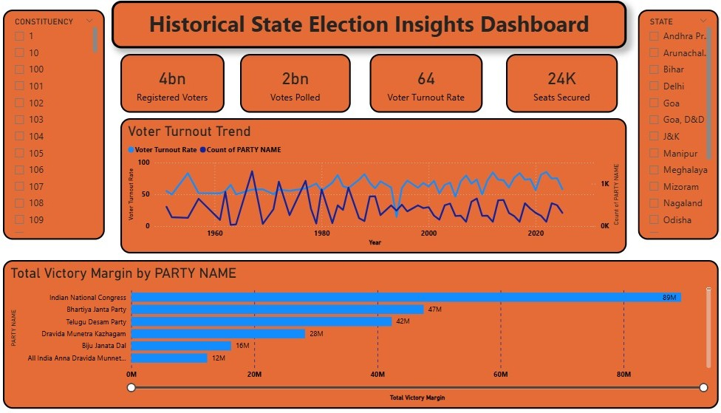
Historical Trends Dashboard

Slide 9
Module 3 – Real-Time Results Dashboard
Vote % bar graphs & seat indicators​.
Live result dashboards.
Interactive filters (region, party, candidate ,year).​
Constituency-level drill-down​.

Slide 10
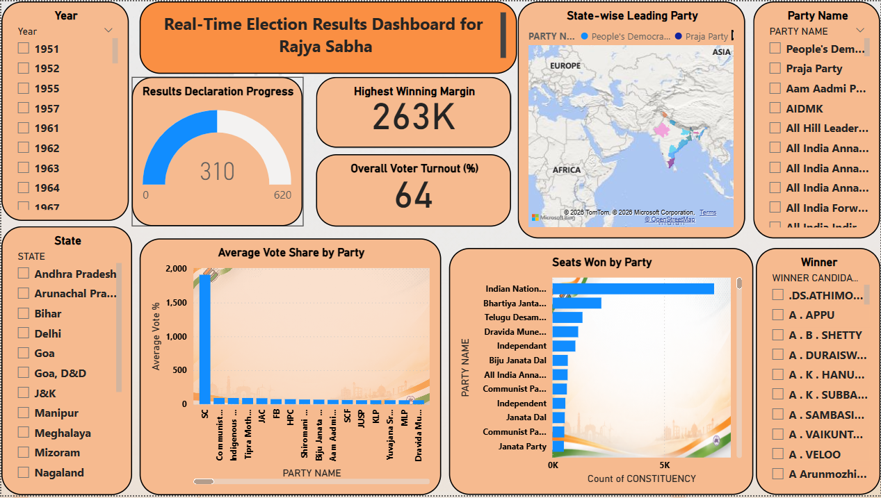
Real-Time Results Dashboard

Slide 11
Module 4 – Turnout & Demographics
Gender-based turnout trends​.
Gender participation insights​.
Heatmaps & pie charts for demographic analysis.​

Slide 12
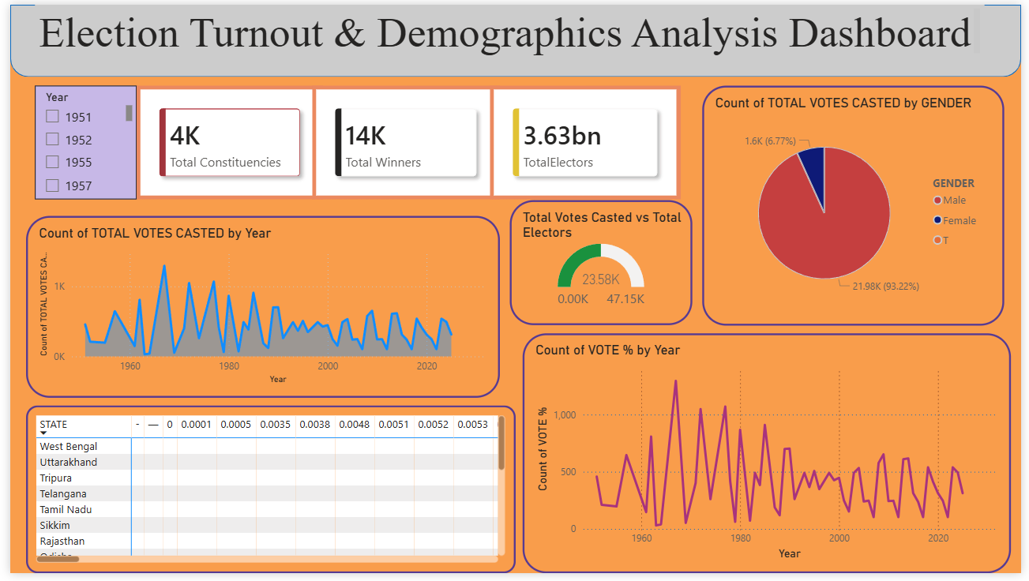
Turnout & Demographics

Slide 13
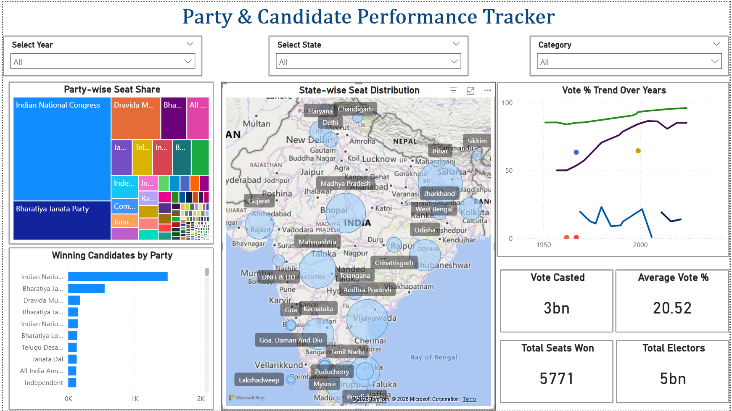
Module 5 – Party & Candidate Performance

Slide 14
Architecture Overview
Data Ingestion Layer – CSVs​
Transformation Layer – Power Query​
Semantic Model – Star Schema​
Visualization Layer – Power BI Dashboards​
Publishing via Power BI Service​.

Slide 15
Impact & Applications
Supports journalism & political reporting​.
Enables fast decision-making during elections.​
Identifies long-term political trends​.
Compares vote-to-seat conversion efficiency​.
Adaptable for future elections​.

